Slide 1

C++ Software Transactional Memory (STM)
Zoltan Fuzesi
Software Engineering
2017/2018
Supervisor : Joseph Kehoe

Slide 2

What is Software Transactional Memory?
Concurrency control mechanism.
    Provide lock free programming.
Similar to database transactions - ACID.
    Atomicity: All changes are made (commit) or none (roll back)
    Consistency: Transaction always transform the state from one consistent state to another.
    Isolation: one transaction cannot read data from other transaction until not committed.
    Durability: STM store data only in memory.
Controlling access to shared memory.
Store object type or primitive type.

Slide 3
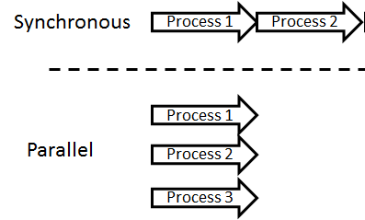
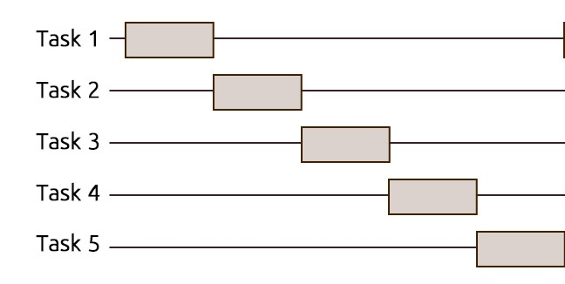
How does it work?
Register original object/shared memory
Restart transaction
Load object/memory
Application
Store object changes
STM library
Commit changes/ make visible
Rollback transaction
STM based threaded environment (parallel)
Lock based threaded environment (sequential)

Slide 4
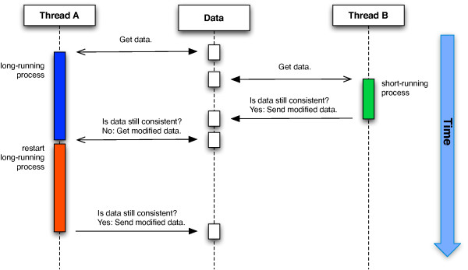
Starvation, version checking
https://www.researchgate.net/

Slide 5
What is ready? What else do I need to do?
When is it ready? Composition, nested transaction, priority?
Code refactoring. Hide some code from .h file.
Library implementation on Windows and Mac OS.
Documentation (Doxygen).
Website with tutorial of library usage.
Benchmarking . Compare with similar libraries???

Slide 6

Questions?

